Slide 1
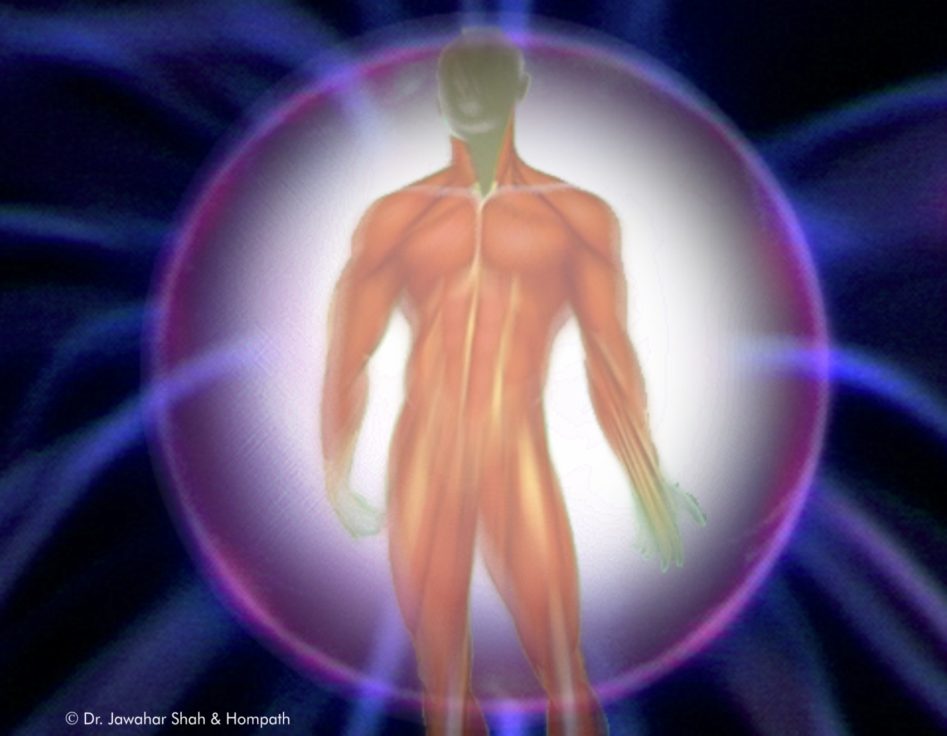
THE METHODS OF DRUG ACTION
&
DIFFERENCE BETWEEN NATURAL AND ARTIFICIAL DISEASES
Dr Anindita Das (MD-1)
Dept of Hom.Pharmacy

Slide 2
OBJECTIVES
SOURCES FOR RECORDING THE DRUG ACTIONS
TYPES OF DRUG ACTIONS
DIFFERENCE BETWEEN NATURAL AND ARTIFICIAL DISEASES

Slide 3
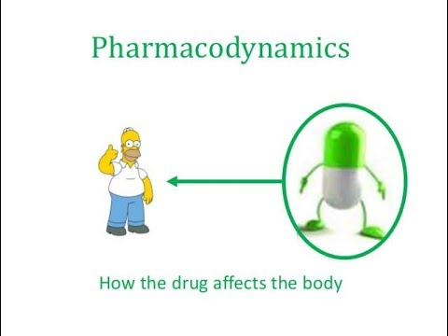

Slide 4
PHARMACODYNAMICS
Pharmacodynamics is the study of drug effects , and attempts to elucidate the complete action-effect sequence and the dose-effect relationship.

Slide 5
Modification of the effects of one drug by another drug and by other factors is also a part of pharmacodynamics

Slide 6
EXAMINATION OF THE OLDER
SOURCES OF MATERIA MEDICA
The first source of the Materia Medica
hitherto extant is mere guesswork
and fiction.
The second source of the virtues of drugs, as ascribed to them in the Materia Medica, has, it is alleged, a sure foundation, their sensible properties from which their action may be inferred.

Slide 7
The third source of Materia Medica
is from the knowledge of chemistry.
The fourth and the last source of knowledge of the common Materia Medica is the knowledge derived from chemical use of drugs, applied not singly, but in combination in actual disease conditions.

Slide 8
HOMOEOPATHIC
PHARMACODYNAMICS
Homoeopathic Pharmacodynamics is
the branch of pharmacology
that helps us to acquire knowledge about
the dynamic actions and effects of drugs within the body

Slide 9
The object is to study individual action of
drugs over and above its general actions,
produced due to specific dynamic action of
drugs.

Slide 10
ASCERTAINING DISEASE
PRODUCING POWER OF DRUGS
HOMOEOPATHIC DRUG
PROVINGS
TOXICOLOGICAL EFFECTS
LAB INVESTIGATIONS AND
EXPERIMENTS

Slide 11
HOMOEOPATHIC DRUG PROVINGS
Carefully conducted homoeopathic drug provings on healthy human beings furnishes the true picture and knowledge of a drug that forms the base for selection of similimum.

Slide 12
TOXICOLOGICAL EFFECTS
Toxicology is the science dealing with properties actions,toxicity,fatal dose,detection,estimation of , interpretation of result of toxicological analysis and treatment of poisons
Facts are usually brought forward in histories and records on toxicology and poisonings.

Slide 13
The knowledge of these changes is
not useful for determining the
peculiar, characteristic, individual
therapeutic properties of the drug.

Slide 14
They help to show the sphere and
nature of action of the remedy.

Slide 15
LAB INVESTIGATIONS &
EXPERIMENTS
Carefully conducted experiments can
determine quantitative and
qualitative changes in the organ and
tissue function and metabolism due
to the effect of the drug under study,
which may be in a large, medium or
small quantity.

Slide 16
This helps to correlate the data with the actual disease state.
This by itself is not much useful in determining the therapeutic action of the drug.

Slide 17
The information collected through provings, toxicological data and experimental data constitute the complete and true Materia Medica.
The sum total effect of the drug is pharmacodynamics

Slide 18
DRUG ACTION
Drug action is the sum-total of the action imparted on an individual living human being and the sum-total of the reaction that it can induce in the vital force for the same.

Slide 19
Drug action depends upon dose and the general receptive capacity of the body mechanism

Slide 20
Principle of drug action:
Drug may stimulate or depress the function.
Pharmacological agents may replace the secretion absent or present in insufficient quantity in man

Slide 21
3. Drugs may alternate or kill the invading organism(e.g. bacteria, virus or fungus), thus affecting the process of cure

Slide 22
Drug-action on Healthy human beings
Drug has threefold action on human beings:
1. Chemical action
2. Mechanical action
3. Dynamic action

Slide 23
Chemical action: Depending on the chemical affinity which exists between drug and body tissue .
This is independent of the vitality

Slide 24
Ex: Strong nitric acid when coming in contact with skin will produce a considerable burning and sloughing of it .

Slide 25
2. Mechanical action: This is exhibited by the effort of the body to throw away the offending substance .
Ex: Due to mechanical action of Ipecacuanha , the offending substance is thrown away by vomiting from stomach.

Slide 26
3.Dynamic action: Dynamic actions are those actions whose technical know how is not explained but effects are perceived. This actions are observed by their effects.

Slide 27
These dynamic effects may be:
1. Generic - common to all the members of
a certain class of drug.
Eg : vomiting, diarhoea, etc may be
generally produced by many remedies.

Slide 28
2. Specific – related to particulars. It mainly depends upon the susceptibility of patient, dose and also condition of application.
E.g. : PQRS symptoms, where symptoms
are peculiar to a specific remedy.

Slide 29
Hahnemann has recognized these actions by primary and secondary action.
The chemical and mechanical action of drug belongs to primary action and dynamic action belongs to secondary action

Slide 30
Primary Action : (§ 63)
Every medicine, deranges the vital force,
and causes a certain alteration in the
health of the individual for a longer or a
shorter period.
This is termed primary action.

Slide 31
Secondary action: (§ 64)
To the primary action, the vital force
endeavours to oppose its own energy.
This resistant action is an automatic action
of the life preserving power, and is termed
secondary action.

Slide 32
E.g. of secondary action
A hand bathed in hot water is at first
much warmer than the other hand that
has not been bathed (primary action) ,
but when it is withdrawn from the hot
water and again thoroughly dried, it
becomes in short time cold, much
colder than the other hand

Slide 33
There are 2 types of secondary action.
a) Secondary counter action- when an exact opposite condition of primary action is possible – the vital force reacts equally and opposite to primary action. Here the principle is contraria contraris curantur (opposite cures opposite).

Slide 34
E.g. In order to stop a diarrhea, a medicine capable of inducing constipation is given.

Slide 35
b)Secondary curative action – when an exact opposite condition of primary action is not possible – the vital force now in differentiates itself and employs its increased energy to extinct the medicinal disease, which gradually decreases and ultimately regains health.

Slide 36
It depends upon principle of ‘similia similibus curantur’-like cures like

Slide 37
The following facts are observed :
After primary action of medicine that produces in large doses a great change in health of a healthy person , exact opposite is produced in secondary action by vital force.

Slide 38
Drugs administered in moderate doses:
Rarely produce secondary action , they only produce primary action with the exceptions in cases of ‘Narcotic Drugs’.
In moderate doses even narcotic drugs produce secondary action (Aph113)

Slide 39
Drugs administered in infinitesimal doses:
Never produce secondary action except in idio-syncratic persons
From Aph 116 , we know the symptoms produced by medicine varies:
a) Some symptoms produced more frequently in many individuals

Slide 40
b) Others, more rarely or in few persons
c) Some only in very few healthy bodies . To the latter category being the so called idiosyncracies

Slide 41
NATURAL DISEASE AND ARTIFICIAL DISEASE

Slide 42
NATURAL DISEASE
(Aph 73, 78,30-50)
A natural disease or proper or true disease is a miasmatic disease.

Slide 43
For precision-
All acute specific infectious diseases and Syphilis , Sycosis ( Gonorrhea) and Psoric group of diseases ( Itch , Scabies , Leprosy , Tuberculosis etc ) are natural or proper or true diseases

Slide 44
ARTFICIAL DISEASE
(Aph 105-145 )
Drug disease; any change (deviation of health) induced (produced) by a drug ; changes seen in the proving of drugs and in poisonings also in addictions ; primary action effects produced in the human beings.

Slide 45
ARTIFICIAL CHRONIC DISEASE (Aph74,75,76,41)
Artificially produced diseased state of chronic nature ; a complicated disease- condition resulting from the admixture of the abuse of drugs and the disease for which the drugs are used .

Slide 46
Such disease conditions-
“are of all chronic diseases the most deplorable , the most incurable”(Aph 74)
“Such a disease should be remedied by vital force itself”(Aph 75)

Slide 47
SUMMARY
Sources Of Drug Action
Drug Action
Three Fold Action Of Drugs
Primary & Secondary Action
Difference between natural and artificial disease

Slide 48


