Slide 1
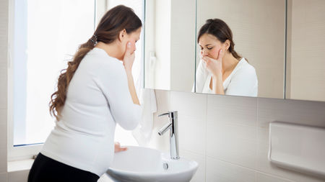
Hyperemesis gravidarum

Slide 2
Hyper : Excessive Emesis : Vomit Gravidarum : Pregnancy
OVERVIEW
It is a severe type of vomiting of pregnancy which
has got deleterious effect on health of mother and/or
Incapacitates her day-to-day activities

Slide 3
ETIOLOGY
Limited to 1st trimester
Familial history
More common in 1st pregnancy
Most common in unplanned pregnancies
Tendency to reoccur again in subsequent pregnancies

Slide 4
SYMPTOMS
Constant nausea with
Persistent vomiting
Loss of appetite
Epigastric pain
Low bp
Fatigue
Headache
Dehydration
Oliguria
Electrolyte imbalance

Slide 5
RISK FACTORS
Age below 17 years & over 35 year
Multiple pregnancy
Primigravidae
Underweight & obesity

Slide 6
INVESTIGATION
Urinalysis
Biochemical & circulatory changes
Ophthalmoscopic examination
ECG
COMPLICATIONS
Convulsion
Peripheral neuritis
Psychosis
esophageal tears
Stress ulcer in stomach

Slide 7
HOMOEOPATHIC THERAPEUTIC
IPECAC
Constant , continuous & persistent nausea with or
without vomiting
Nausea not relived by vomiting
Vomiting of food bile & mucus
Stomach feels relax as if hanging down
Desire for sweet & aversion to all food
Clean tongue with much saliva but no thirst

Slide 8
COLCHICUM
Nausea , vomiting & faint at the smell of cooking food
especially smell of cooking of egg & meat
Nausea while riding in carriage car sickness
Profuse saliva , vomiting of mucus , bile & food but
aversion to food which is offered
Abdomen is extremely distended & feels as if it would
burst

Slide 9
SEPIA
The smell of food makes her sick
Even smell of cooking food , she get nausea
All gone sensation in stomach , not relived by eating
Nausea in morning before eating
Longing for acids & pickles

Slide 10
TABACUM
Nausea worse from smell of tobacco smoke
Vomiting on least motion
Sinking feeling in pit of stomach
Sense of relaxation with nausea

Slide 11
ARSENIC ALB.
Can’t bear the sight of food
Nausea & vomiting after eating & drinking with great
prostration & debility
Thirst for small quantity of water at small interval
Mentally restless but physically too weak to move
Mid night aggravation

Slide 12
PHOSPHORUS
Sight of water excite her vomiting
Cold water which is thrown of as soon as it gets warm
in stomach
Empty all gone sensation in stomach
Craving for cold food & cold drinks
She is over sensitive to light , touch & odour

Slide 13
Presented by : khusbu pandor
Student of final year B.H.M.S
Ahmedabad homoeopathic medical
college

