Slide 1
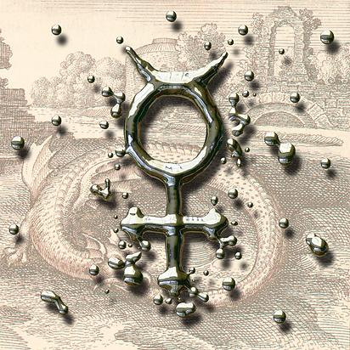
Mercury group
Submitted by: Dr. Kruiti Saraswat

Slide 2
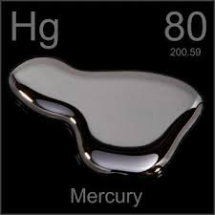
Molecular Formula: | Hg
Synonyms: | Hydrargyrum Quicksilver Liquid silver Mercurio Mercure
Molecular Weight: | 200.59 g/mol

Slide 3
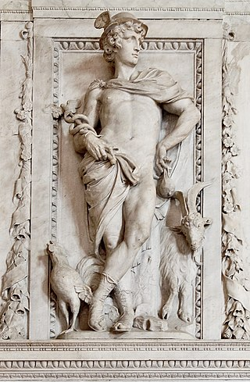
SIGNATURE
Mercurius is named after the Roman God Mercurius, the God of financial gain, commerce, communication, travelers, trickery, merchants and thieves.
The planet Mercurius is named after the same God.

Slide 4
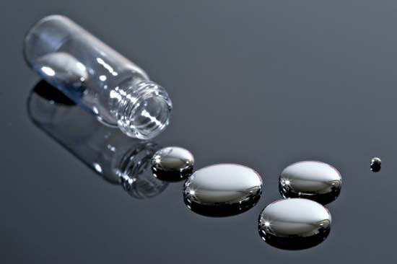
‘Hydrargyrum’
Meaning- "water-silver“/ “quick silver”
Its shine and colour are very similar to silver.
The word ‘quick’ describes its tendency to scatter away in all directions.
The droplets have a tendency to conglomerate to one big mass, but on being shaken they fall apart into countless little droplets again.

Slide 5
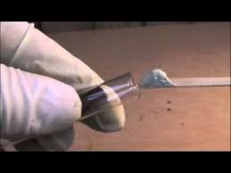
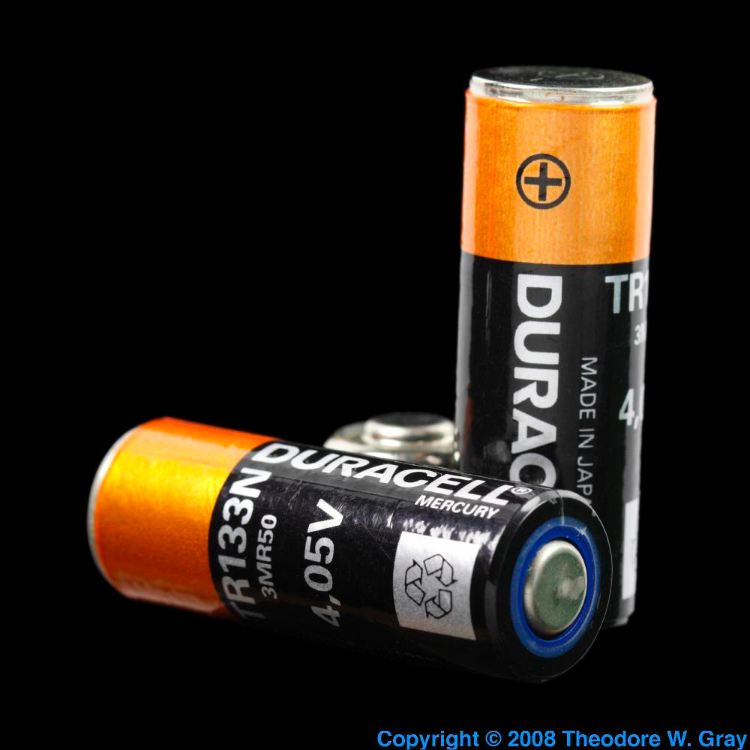
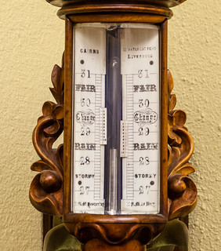
USES OF MERCURY
Thermometer
Fulminants
Batteries
Barometer

Slide 6
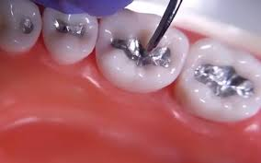
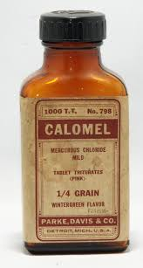
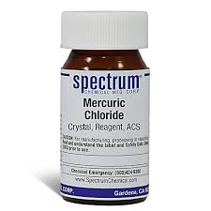
MEDICAL USES
Used as a component for dental amalgams for making fillings for teeth.
Mercurous chloride (Hg₂Cl₂), (calomel), is an antiseptic used to kill bacteria.
Mercuric chloride (HgCl₂) used to disinfect wounds.

Slide 7
Characteristic Mentals

Slide 8
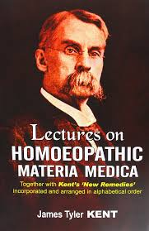
Kent’s viewpoint

Slide 9
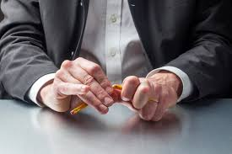
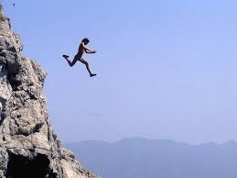
IMPULSES ARE CHARACTERISTIC
Patient will not tell you about his impulses but they relate to deep evils of the will, these impulses fairly drive him to do something destructive.

Slide 10
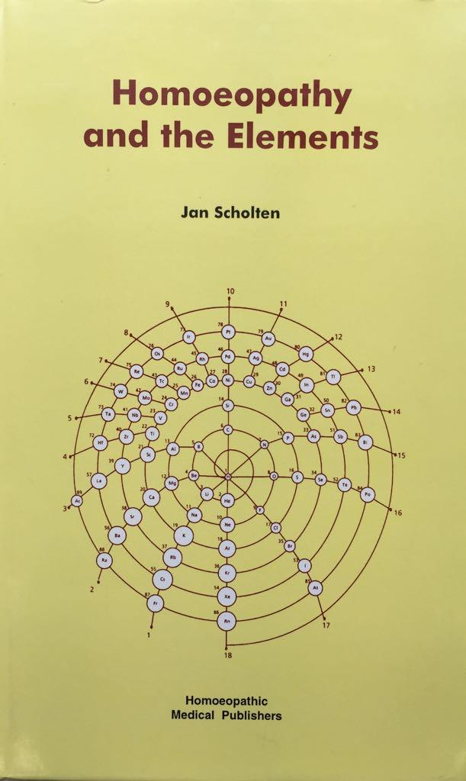
Jan Scholten Explaination

Slide 11
ESSENCE: the position of power is being threatened.

Slide 12
Exaggerated power: tyranny
They want to hold the power at any cost, also they have constant fear of losing their power.
Their thirst for power turns them into real tyrants, using the techniques of: 'divide and rule'.

Slide 13
Exaggerated responsibility
The responsibility for their task is very important to them.
They dare not hand over to anyone else out of fear that it might all go wrong.
They are hard workers, can be workaholics.

Slide 14
Enemies of the organisation: suspicion
Their exaggerated control and dictatorial behaviour doesn't make them very popular.
There are enemies all over the place and they don't know who they can trust anymore.

Slide 15
Manipulation
They would register and control every single thought and every single act if they were given the chance.
Try to mislead other people so they can remain in control.

Slide 16
Repeating same strategies
The are very conservative and want everything to remain the same.
They cannot move with the times, that is why the times turn against them.
There is a shortage in one area and a surplus in another and it becomes impossible to even it out.

Slide 17
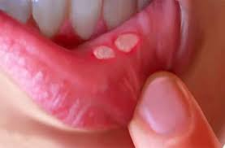
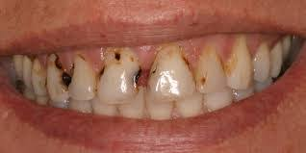
Exaggerated arrogance
This is symbolic for the physical symptoms we find in Mercurius: ulcers, caries of the teeth, syphilis, etc.

Slide 18
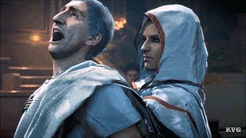
Enemies have to be controlled with dictatorial measures
Deep inside their is an impulse to murder everybody, to kill them with a knife, to stab them with a hot iron rod.
They are very afraid of death themselves, afraid that their enemies will kill them to take over the reign.
Betrayal is a very strong theme in this remedy.

Slide 19
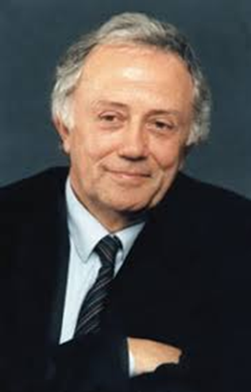
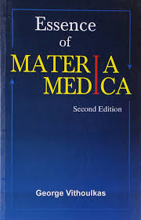

Slide 20
Vithoulkas says: 'Mercurius has a narrow range of tolerance to everything'. They are a living thermometer (Kent).
At one moment, he is suffering from cold and seeks warmth, but once warm he becomes aggravated by the warmth also.
There is also a weakness and instability in emotional expression; weeping alternating with laughing.

Slide 22
Stages of development of pathology on mental plane
STAGE 1- SLOWNESS OF ACTION
Mercurius is both slow of mind and poor in comprehension
[Comapare- Calcarea carb- Slowness of mind, but once comprehended, able to use the idea efficiently.
Phosphorus & Phosphoric acid- Slow to answer.]
Mercurius is worthlessly hurried (doesn’t accomplish anything inspite of hurriedness)
[Compare Tarentula, Sulphuric acid, Nux vomica- Hurried but productive.]

Slide 23
STAGE 2- IMPULSIVITY
Vulnerability to stimuli from without & within-unable to keep his mind concentrated purely in a particular direction.
Every random thought patient feels need to respond.
Progress to Extreme Pathology- Impulse to strike, to smash things.
To kill someone over a merely slight offence.
To killed loved ones (like Merc, Nux vom,Platina).

Slide 24
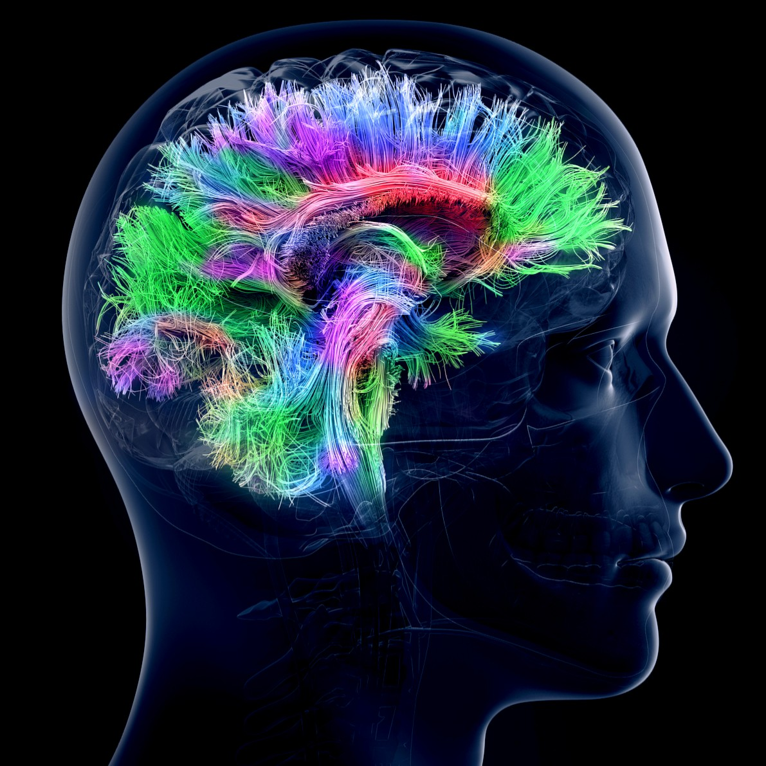
STAGE 3- PARANOID STATE.
So vulnerable that he begins to perceive everyone as his enemy.
Not actually insane, but feel he is going insane..
Fear of insanity Agg night.

Slide 25
STAGE 4- LACK OF REACTIVE POWER.
It cannot even generate an Insane state.
Instead develops Imbecility.
Sensation-Brain becomes softened & incapable of reacting.
All stimuli are absorbed & no longer comprehended.

Slide 26
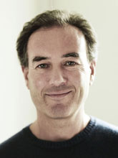
PHILIP M.BAILEY EXPLAINATION

Slide 27
Unique-Poles
“One foot in the world of dream and other in the real world”.
Two Extreme Modes
a)cold logic & astute institution.
b)pragmatism & mysticism
c)austerity & hedonism
d)introvert & extrovert
e)optimist & pessimist

Slide 28
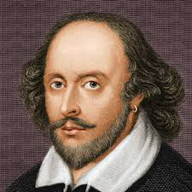
Mercurius individuals are gifted writers or speakers.
Mercurius loves a play on words. Manipulate words into any form, for any purpose.
Sudden inspirations & maddening distraction by Trivial Thoughts. E.g. Shakespeare.

Slide 29
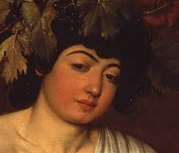
Puer/Puella
Carl Jung: Puer is a person who never really grows up, yet is charming, self obsessed & often manipulative.
Inherent good at manipulating people to get his own way, both through charm & less attractive methods, such as tantrums.

Slide 30
Love
Can be totally open with another about himself, especially with one of the opposite sex.
Fall instantly in love, propose & then fall instantly out of love.
Completely takes love for granted.

Slide 31
Detachment & Alienation
Function primarily from mind rather than the emotions.
[Lycopodium-is as mental as mercurius.]
Mercurius mind-tremendous plasticity & flexibility.
Detached-Does not bother with the highly personal struggle for self confidence & self respect that occupies the minds of many Lyco.

Slide 32
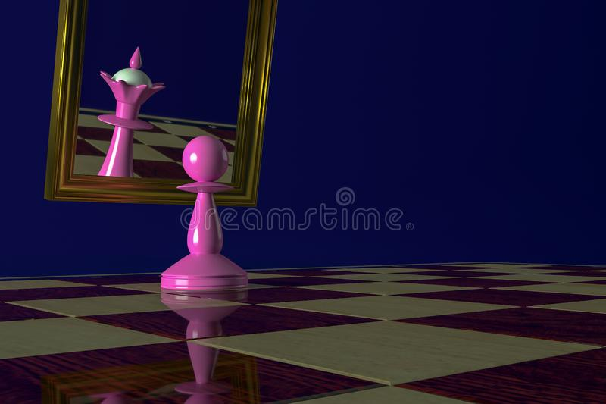
Megalomania & Cruelty
Tendency to have everything ones own way, if doesn’t get it, creates havoc.
When Dictator does not get its own way, he kills.
Inflation of ego which is accompanied by real mental agility, perceptiveness,Intuitive psychic sense.

Slide 33
Characteristic Physical features

Slide 34
Congestive
Merc is basically inflammatory group of remedies.
Every inflammation begins with congestion.
Merc presents conditions where suppuration has supervened.
[Unlike Aco, Bell or Ferr-ph., these three drugs have congestion in their first stage of inflammation.]
An abscess in Merc is of spreading congestion- more red, more painful, more throbbing, and with adjacent lymphadenopathy.

Slide 35
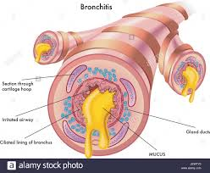
Catarrhal
Merc causes inflammation of mucous membranes resulting in profuse, thin, slimy, acrid, burning, foul or thick greenish-yellow discharges.
Merc covers simple to malignant catarrhs in its pathogenesis.

Slide 36
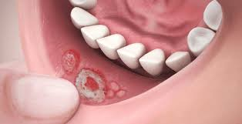
Ulcerative
Merc has ulcerations; of the mucous membranes, esp. of mouth and throat.
The syphilitic miasmatic dimension is responsible for recurrent and non-healing ulcerations.
Ulcers based on deep pathologies, or metabolic basis.

Slide 37
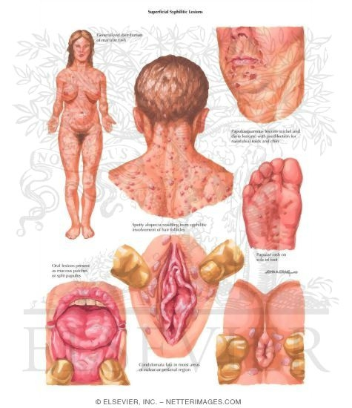
Destructive
Merc is destructive both at body and mind levels.
Merc transforms healthy cells into decrepit, inflamed and necrotic wrecks.
Lesions resemble those of syphilis.
Inflammations of malignant types, and prostration.

Slide 38
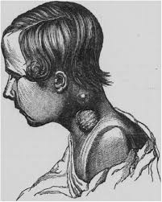
Scrofulous
Tuberculous disease of lymphatic nodes and of bone, with slowly suppurating abscesses.
Merc decomposes the blood, it thus affects the nutrition and prepares a ground for scrofulous affections.
Syphilitic activity further leads to cachexia.

Slide 39
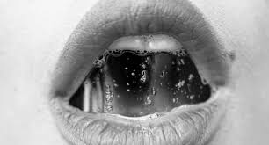
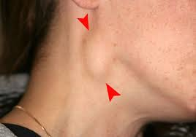
Glandular
Merc has increased glandular activity, esp. of salivary and mucous glands produces increased salivation.
Merc has concomitant lymphadenopathy with skin lesions like boil, abscess, ulcer etc.
Based on scrofulous diathesis, it also covers tubercular glandular affections. Chronic suppurating glands and cold abscesses.

Slide 40
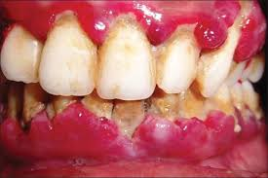
Scorbutic
Merc has spongy and bleeding gums.
When the general condition is impaired and metabolism affected because of malnutrition, scorbusis may get developed.
Scorbusis may be a precursor of metabolic diseases like DM.

Slide 41
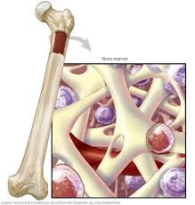
Anaemic
Merc through decomposition of blood, and through bone-narrow depression causes profound or aplastic anemia.
Hemorrhages, metabolic disorders, hepatic and renal toxicity cause anemia.

Slide 42
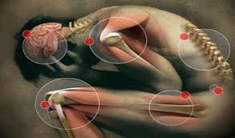
Rheumatic
Rheumatic diathesis is one of the features of Merc group.
It has both acute and chronic dimensions.
Mercs are sensitive to both heat and cold – human barometers and they come down with acute joint swellings and pains consequent to weather changes. ‘Redness’ indicates Merc.

Slide 43
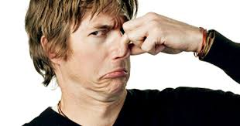
Offensive
Merc is filthy, mentally as well as physically.
All discharges smell horribly.
The decomposition, the debris, the slough, the suppuration; smell emanates from the body.

Slide 44
Sensitive
Mercs are very sensitive to weather changes, hence termed as ‘human barometer’.
Sensitivity attracts environmental stimuli; hence modalities or sensory stimuli / inputs are usually available.
Sensitivity is also present at mind level.

Slide 45
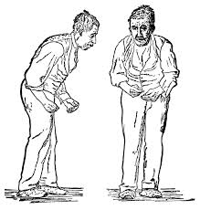
Tremulous
‘Trembling’ is a marked characteristic of Merc. Paralysis agitans – Parkinsonism –come under pathogenetic action of Merc.
Syphilitic expressions with a lot of pathologies at nerves, spinal cord, and brain resulting in inco-ordination are responsible for tremulousness.

Slide 46
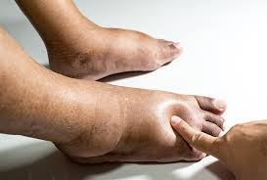
Dropsical
Dropsy due to anemia, hepatic, renal or cardiac affections are covered by Merc.
Edematous swellings in the affected parts characterize Merc.

Slide 47
Characteristic particulars

Slide 48
ORGAN/ SYSTEM | ACTION/ SYMPTOMS
LYMPHATIC, GLANDULAR SYSTEM | Paralysis, Congestion, Ulcer.
SALIVARY GLANDS | Salivation, Excessive fetor.
PANCREAS | Salivation, congestion. inflammation. hypertrophy.
LIVER | Secretion of bile greatly increased, jaundice.
KIDNEYS | Congestions, inflammation, albuminuria, diabetes.
MUCOUS MEMBRANE (INTESTINAL) | Congestion, catarrhal inflam.mation, haemorrhage.

Slide 49
ORGAN/ SYSTEM | ACTION/ SYMPTOMS
INTESTINAL CANAL | Increased peristalsis.
SEROUS MEMBRANES | Inflammation, effusion
PERIOSTEUM | Congestion, inflammtion, rheumatism.
BLOOD | Decomposed, Fibrine, Albumin, red cells decreased.
SKIN | Vesicular and pustular eczema.
SEXUAL ORGAN, FEMALE | Menorrhagia, amenorrhoea, miscarriage.
CEREBRO-SPINAL SYSTEM | Mercurial palsy, tremors.

Slide 50
General features
Diathesis: Scrofulous
Miasm: Syphilis-traces of Psora and Sycosis
Side affinity: Right mainly.
Aggravations:
Extremes of heat and cold, changing climate
Night
Sweating – during & after
Lying in all positions except lying on rt side (dyspnoea).
Loss of Sleep
Amelioration:
Moderate temp and altitude
Discharges
Sleep, rest

Slide 51
Important remedies
1. Mercurius Solubilis- contains ammonia & nitrate (Hg + NH₄ + NO₃ )
2. Mercurius- hydragyrum/merc vivus- quick silver
3. Mercurius corrosivus- corrosive sublimate
4. Mercurius dulcis- calomel
5. Mercurius iodatus flavus- Merc protoiodatus- Iodide of Hg
6. Mercurius biniodatus- Merc iodatus ruber- Merc-i- r

Slide 52
7. Mercurius aceticus- Merc-a
8. Mercurius cyanatus
9. Mercurius sulphuratus rubber (merc sulphide)- Cinnabaris
10. Aethiops mercurialis mineralis- Black sulphide
12. Mercurius sulphuricus- Merc-sul

Slide 53
Mercurius — Quicksilver
In bone diseases, pains worse at night; glandular swellings with or without suppuration, but especially if suppuration be too profuse (Hep., Sil.).
Profuse perspiration does not relieve; may even increase the suffering
Catarrh: with much sneezing; fluent, acrid, corrosive; nostrils raw, ulcerated; yellow-green, fetid, pus-like; nasal bones swollen; < at night and from damp weather.
Toothache Crowns decay, roots remain
fetid, coppery, metallic-tasting saliva.
Tongue: large, flabby, shows imprint of teeth
Mumps, diphtheria, tonsillitis with profuse offensive saliva; constant desire to swallow;

Slide 54
… Mercurius contd.
Dysentery: stool slimy, bloody ,with colic and fainting
Leucorrhoea itching with rawness; always worse at night;
Mammae painful, ulcerate at every menstrual period
Relations. – Follows well: after, Bell., Hep., Lach., Sulph., but should not be given before or after Silicea.
If given in low (weak) potencies hastens rather than aborts suppuration.
Aggravation. – At night; wet damp weather (Rhus); in autumn, warm days and cold, damp nights; lying on right side; perspiring. Mercury is < by heat of, but > by rest in, bed. Arsenic is > by heat of, but < by rest in, bed.

Slide 55
Mercurius aceticus
Mercurous acetate, HgC₂H₃O₂
"Pressure in lower sternum and dyspnoea on standing erect" is a noteworthy symptom.
"Margins of ulcers become painful."
Hahnemann has bracketed a symptom referring to the menses which came on at the new moon, four days before their proper time.

Slide 56
Mercurius corrosivus
Corrosive sublimate, HgCl₂
Diseases of men, syphilitic; ulcers, with corroding, acrid pus; Bright’s disease.
Dysentery and summer complaints of intestinal canal, occurring from May to November.
Tenesmus: of rectum, not >> by stool (< by stool, Nux); incessant, persistent; stool hot, scanty, bloody, slimy, offensive; shreds of mucous membrane and terrible cutting, colicky pains. More the pain merc cor is indicated and more blood merc sol is indicated
Tenesmus: of bladder, with intense burning in urethra; urine hot, burning, scanty or suppressed; in drops with great pain; bloody, brown, brick-dust sediment; albuminous.
Gonorrhoea: second stage, greenish discharge, < at night; great burning and tenesmus.

Slide 57
Mercurius biniodide
Mercurius iodatus ruber
Biniodide of Mercury, HgI₅
Diphtheritic and glandular affections of left side; fauces dark red; solids or liquids painful when swallowing; exudation slight, easily detached; cases attending epidemic scarlet fever, ulcers on fauces or tonsils; glands enlarged; greenish tough lumps from pharynx or posterior nares.
Tubercular pharyngitis.

Slide 58
Mercurius iodatus flavus
Iodide of mercury— Hg₂I₂
Diphtheritic and throat affections where the cervical and parotid glands are enormously swollen; membrane begins on or is < on right side; < by warm drinks, and empty swallowing (Lach.).
Tongue: thick, yellow coating at base (Kali bi._ golden yellow coating at base, Nat. p.; dirty or greenish-gray coating at base, Nat. s.); tip and edges red; right side of throat and neck most affected.
For Hunterian (hard) chancre, secondary symptoms rarely follow if given in proper dose; great swelling of inguinal glands, no disposition to suppurate.
Mammary tumors, with tendency to much warm perspiration and gastric disturbances.

Slide 59
Mercurius dulcis
Calomel Hg₂Cl₂
Catarrhal affections of mucous membranes, especially of the eye and ear. Catarrhal inflammation of middle ear (Kali m.).
Eustachian tube closed; catarrhal deafness and otorrhoea in psoric children; deafness of old age (Kali m.).
Acute affections of prostrate after maltreated stricture.
Deafness and catarrhal affections of nares, throat, and pharynx, from mercurial amalgam fillings. Diarrhoea: of children; stools grass-green; like chopped eggs; profuse, causing soreness of anus.

Slide 60
Cinnabaris
Mercuric sulphide
For certain forms of ciliary neuralgia and ulceration upon a syphilitic base, this remedy is most effective.
Sleepless during night.
Eyes- Pains from lachrymal duct around eye to temple, from inner canthus across brows to ear.
Severe shooting pain in bones of orbit, especially running from inner to outer canthus in the bone. Redness of whole eye.
Lids granulated; canthi and lids red.

Slide 61
Mercurius sulphuricus
Sulphate of Mercury, HgSO₄
Hydrothorax, if occurring from heart or liver diseases; dyspnoea, has to sit, cannot lie down.
“When it acts well it produces a profuse, watery diarrhoea with great relief to the patient; it is as important as Arsenicum in Hydrothorax.” _ Lippe.
Desires: alcohol, drugs, bread and butter, sweet, cold water.
Aversion: meat, eating, sweet, butter, alcohol, coffee, fat.
Amel. eating, agg. fasting.

