Slide 1
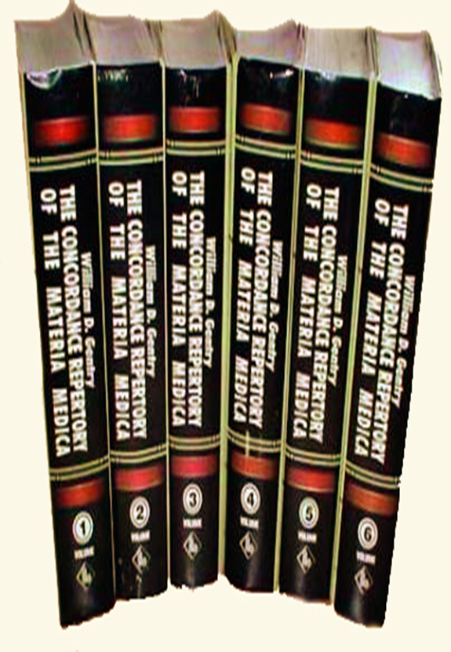
The Concordance Repertory of the more Characteristics Symptoms of the Materia Medica. By William Daniel Gentry
Presented By
DR. SWATI PANDEY
DR. RAJ K. PANDIT
B.H.M.S, M.D. (HOM)
MAHESH BHATTACHARYYA HOMOEOPATHIC
MEDCAL COLLEGE & HOSPITAL, WEST BENGAL

Slide 2
Meaning Of CONCORDANCE
The word Concordance means, state of being of the same heart and mind, harmony.
Arrangement in ABC order of important words used by the author or in a book.
This word “Concordance” appeared first in the homoeopathic literatures by Boenninghausen, which was then replaced by Allen to- “Relationship of Remedies” to make the title more comprehensible.
Concordance repertory belongs to the Puritan group of repertories where the symptoms are given in their original form without much change or is based on alphabetical arrangement of original symptoms of Materia Medica i.e. indexing the symptoms without much modifying them.

Slide 3
Full name:
The Concordance Repertory of the more Characteristics Symptoms of the Materia Medica.
Author:
William Daniel Gentry, MD
First edition: 1890
Second edition: 1892
Includes:
30 chapters, 5494 pages,
6 volumes, 420 medicines

Slide 4
Origin of Repertory
The idea which finally gave origin to the work presented itself to the author in the autumn of 1876.
Author wanted to find a remedy for the symptom-
which caused the search is -"Constant dull frontal headache, worse in the temples, with aching in the umbilicus", that peculiarity made it difficult to find.
After a weary search and final success in finding the remedy- {LEPTANDRA (abdomen- aching pg18) } the Author exclaimed------

Slide 5
–“if only we had a repertory arranged on the plan of Cruden's Concordance of the Bible it would have been necessary only to refer to the letter ‘U’ and under ' umbilicus ' find at once the desired symptom.”
It was decided then that the attempt should be made to materialize the thought into actuality, and with a determination the work was begun.
Cruden’s Concordance of the Bible gives two or three words only in each sentence, necessitating a reference to the Bible to find the complete sentence, in this way all the work is included in one volume .

Slide 6
But such is not possible with the CONCORDANCE Repertory,as there are many Materia Medicas.
In consequence of this fact the author used the PHRASEOLOGY of the symptoms, whenever possible without altering the sense.
This necessitated the re-writing of many symptoms of materia medica and thus employing the Six large volumes of repertory.

Slide 7
PLAN AND CONSTRUCTION
1.Preface
2.List of abbreviations
3.Explanation
4.Chapters

Slide 8
Preface-
The concordance repertory is designed to enable the physician to find quickly and certainly any desired symptom in the Materia Medica together with the indicated remedy.
The rules adopted for the preparation of the work are-
1) Select and give all the more characteristic pathogenetic symptoms.
2) Include only such clinical symptoms as have been repeatedly verified.
3) When two or more remedies have the power of producing a similar condition, include them as merely suggestive, under the name of the condition produced.

Slide 9
4) Give the noun, verb, and essential adjective in the sentence.
HOW TO SEARCH RUBRICS-
A). In searching for any desired symptom, the physician should first express it mentally, or better in writing, employing words commonly used, and then select the word in the sentence expressing the central thought, idea, fact, condition or object of the sentence or the noun, verb, essential adjective, and referring in the concordance to the word selected . (The synonyms should also be thought of)

Slide 10
E.g.
(1). “Imagination of having two heads.”-is a mental symptom, should be found in the section devoted to the Mind and Disposition.
'Imagination' -being a noun, the first word and word expressing the central thought, we select that, and turning to the letter ' I' in the proper section, find the word in the bold face letters and follow it with the desired symptom, together with all other symptoms in the Materia Medica in which the word “imagination” appears, grouped together, convenient for consideration and comparison.

Slide 11
(2).“Fancies seeing cats and dogs”-This may be found in C following “cats”, In D following “dogs” and in F following “Fancies” .
And in like manner any symptoms can be found .
(B).Frequent difficulty may be met in finding a symptom on account of difference in Phraseology of the Materia Medica writers or upon the part of the person desiring to find the symptom . Therefore when there is a failure to find a symptom under one word ,the synonym should be thought of.

Slide 12
E.g.
(1). “Desire to kiss everybody” – we get that symptom as – wants to kiss everybody. Think of the synonym “want” want or some other word in sentence ,such as “kiss” or “everybody”.
LIST OF ABBREVIATION OF MEDICINES
From Abies Canadensis - Zizia aurea. Total of 420 drugs are dealt within this repertory.

Slide 13
CHAPTERS
Volume 1: Includes [835 pages]
Number of Chapter Number of Rubrics
1.Mind and disposition 1558
2.Head and scalp 722
3.Eyes 1089
4.Ear 545
5.Nose 654
6.Face 948

Slide 14
Volume 2: INCLUDES 889 pages]
Number of Chapters Number of rubrics
1.Mouth 1028
2.Throat 904
3.Stomach 1376
4.Hypochondria 537

Slide 15
Volume 3: [930 pages]
Number of Chapters Number of Rubrics
1.Abdomen 1037
2.Anus,Rectum, Stool 2454
3.Urine, Urinary organs 4828
4.Male sexual organs 5840

Slide 16
Volume 4: INCLUDES[976 pages]
Number of Chapters Number of Rubrics
1.Uterus and appendages 1487
2.Menstruation and discharges 3749
3.Pregnancy and parturition 7454
4.Lactation and mammary glands 6641

Slide 17
Volume 5: INCLUDES[956 pages]
Number of Chapters Number of Rubrics
1.Voice, larynx, trachea 546
2.Chest, lungs, bronchia and cough 2512
3.Heart and circulation 6879
4.Chill and fever 6365
5.The skin 6766
6.Sleep and dreams 3707

Slide 18
Volume 6: INCLUDES [908 pages]
Number of Chapters Number of Rubrics
1.Neck and back 598
2.Upper extremities 2107
3.Lower extremities 2576
4.Bones and limbs in general 3423
5.The nerves 5327
6.Generalities and Key Notes 6553

Slide 19
SOME FEATURES OF THE REPERTORY
On the top of the page ,1st 3 alphabets of the starting rubrics in Capital Bold on one side and on the other side page number and in the middle chapters name in italics is given.
Rubrics are given in Roman Bold followed by dot and line, are arranged Alphabetically.
Eg. Ache.- (pg-17,vol-2)
Subrubrics are also arranged in Alphabetical order but not strictly followed.
Eg. Angry (pg-26, vol-1)
Before starting with subrubrics first alphabet of main rubric given in Bold.
Eg.-Cadaverous.- C. odor from mouth (pg-37, vol-2)

Slide 20
Subrubric which are having the main rubric word in between sentence, will be given as first alphabet of main rubric in small letter .
Eg. Butter.- Taste of b. sour (pg37,vol-2)
From his clinical experience he has given a lot of information under some rubrics .
Eg. Lower extremities-Stinging.-acute arthritic rheumatism…….. Acon. (Also apply cloth saturated with dilution) (pg 471,vol-6)
Cross reference are given after the rubrics in bracket.
Eg. Neck and Back – Palsy (see Paralysis,also section on nerves).- (pg 103,vol- 6)

Slide 21
The remedy have reverse action of given rubric is given in bracket and mentioned reversed at the starting followed by drug .
Eg. Mind and Disposition–Child.- C. cries;quiet only when carried. Cham. (Reverese , Cina) (pg55, volume 1)
The remedies in the bracket indicated that they have some other related rubric.
Eg. Upper extremities – Fingers.- Drawing and tearing in arm and f. Sep. (Nux-v. ) (pg191 ,vol-6)
In some rubrics diseases which produces that particular conditions are given in bracket.
Eg.Neck and Back-Tender.-Neck t. and swollen (in scarlatina) (pg -147,vol -6)

Slide 22
In some rubrics with which condition it is associated given in bracket.
Eg. Lower extremities-Ankles.-Oedema of feet and a. (with bronchial catarrh) (pg-296,vol-6)
In some rubrics for whom it is best indicated or in whom it produced given in bracket.
Eg-Lower extremities-Ankle .-Weakness of a. (in children).Carbo-an. (pg-296,vol-6)
Some rubrics are sequel of particular condition, those conditions are given in brackets.
Eg.6th volume Lower Extremities-Arms.- Paralysis of legs(after suppression of eruption on a. ) (pg-296,vol-6)

Slide 23
In some rubrics drugs are given in brackets with rubrics and condition’
Eg. Lower extremities – Better.- Gangrene; b. from heat. Ars. (Worse from heat. Sec. ) (pg301,vol-6)
Only one Gradation is used i.e. Roman.

Slide 24
Merits of the Book
Useful as a book of reference, to find the desired symptom together with the indicated remedy.
The symptoms are given in their original form without much change.
In the repertory the author has used the phraseology of Materia Medica without much change.
Symptoms can be found easily, which saves a lot of time.
One symptom can be referred to at many places.
Eg. Confusion in head, which makes thinking difficult. This can be referred to under ‘Head and Scalp’ and also under ‘Mind’

Slide 25
Demerits of the Book
This repertory is not useful for systematic Repertorization of a case.
One who uses the book should have a thorough knowledge of synonyms for the desired symptom.
All medicines are given the same grading.
The abbreviations given for the medicines are different from other books.

Slide 26
BIBLIOGRAPHY
Gentry william.d.; THE CONCORDANCE REPERTORY OF THE MORE CHARACTERISTIC SYMPTOMS OF THE MATERIA MEDICA
Tiwari SK. Essentials of Repertorization. 4th Edition. B. Jain Publishers Pvt. Ltd. New Delhi; 2010
Similima.com

Slide 27
THANK YOU

