Slide 1
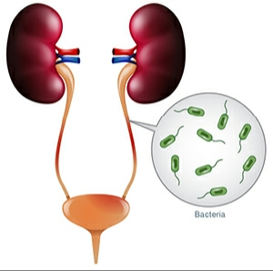
PYELONEPHRITIS
PARUL UNIVERSITY
RAJKOT HOMOEOPATHIC MEDICAL COLLEGE
Author :- Vaghela Sandip
3RD YEAR B.H.M.S.

Slide 2
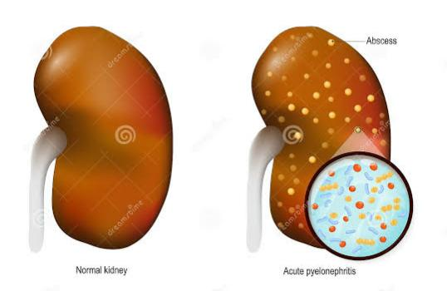
ACUTE PYELONEPHRITIS
The term ‘pyelonephritis’ means inflammation of the kidney and renal pelvis. The term ‘pyelitis’ means inflammation of the renal pelvis only, but it is doubtful whether such condition can exist alone or not.

Slide 3
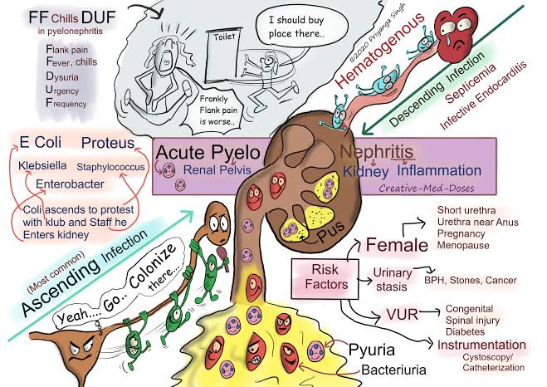

Slide 4
Pathogenesis
In this condition bacteria reach the kidney either through the blood stream or by ascending infection.
(A)ASCENDING INFECTION.— In majority of cases acute pyelonephritis develops from infection in the bladder through the mechanism of vesicoureteral reflux. Prone to this reflux causes recurring of infections. Acute pyelonephritis is quite common after marriage (‘Honey-moon pyelitis’) and during pregnancy.
(B)HAEMATOGENOUS INFECTION.— Pyogenic cocci are more often seen in haematogenous infections, though E.coli is the commonest infecting organism in all cases of pyelonephritis. In case of haematogenous infection element of obstruction is of greatest importance.

Slide 5
Pathology
MACROSCOPIC FEATURES.— The affected kidney is usually swollen and congested and the pelvis is bright red with pus inside. The surface of the kidney becomes dull. Under the capsule there are numerous yellow spots representing areas of suppuration. ●On cut surface the sharp demarcation between the cortex and the medulla is lost. Patchy areas of suppuration are seen which are spherical in the cortex and linear in the pyramids. Wedge shaped areas of larger size are suggestive of infarcts, and represent upward extension of infection. Multiple small abscesses may also be seen. ●The outline of the calyces is destroyed and the resulting distortion is seen in X-ray film, which is an important feature of diagnosis.

Slide 6
MICROSCOPIC FEATURES
There are many small abscesses with widespread interstitial infiltration with polymorphonuclear leucocytes.
There is diffuse or spoty inflammation characterised by oedema and small haemorrhagic areas.
There are also linear round cell infiltration with admixture of polymorphonuclears. It is the renal tubules which bear the major brunt.
There is destruction of the renal tubules with gradual replacement by scar tissue. Many tubules are filled with pus cells.
In the renal pelvis there is round cell infiltration and fibrosis.

Slide 7
Clinical features
Acute pyelonephritis is more common in females particularly during pregnancy and soon after marriage, Which is popularly known as ‘honeymoon pyelitis’.
Affects right side more often than the left but it may be bilateral.
(i) Constant ache over one or both kidneys is the most frequent complaint. The pain may radiate to the lower abdomen or to the groin mimicking ureteric colic.
(ii) Children often complain of vague abdominal discomfort instead of localised renal pain.
(iii) Increased frequency of micturition, urgency, nocturia and burning sensation on urination are the complaints due to cystitis which is often accompanied with.
(iv) Prodromal symptoms e.g. headache, lassittude, nausea, vomiting and prostration are often complained of.
(v) Rigor alongwith high temperature is quite common.

Slide 8
PHYSICAL SIGNS
(i) Among general signs increased temperature, which often shoots upto 104° F, increased pulse rate (which may vary according to the type of infecting organism; In E.coli infection the pulse rate may be only 90/min. In Staphylococcal infection pulse rate may be as high as 140/min ).
(ii) In local examination, tenderness at the renal angle.
(iii) Percussion over the renal angle may be painful.
(iv) Abdominal distension with quiet intestine revealed by auscultation can be elicited in acute cases. Rebound tenderness may also be elicited if there is intraperitoneal infection.

Slide 9
Pyelonephritis of pregnancy
Pyelonephritis of pregnancy usually occurs between the fourth and sixth month of gestation in women who have a past history of recurrent uri- nary infection.
In about 10 per cent of cases the disease runs a severe and protracted course and occasionally leads to abortion or premature birth.

Slide 10
Special Investigations
1. BLOOD EXAMINATION — reveals high neutrophil count. The E.S.R is increased. .
2. URINE is usually scanty and highly concentrated. It is usually cloudy. Protein content becomes high. Urine contains large amounts of pus and bacteria. A few red cells may be noted in the urine. Bacteriological examination of the urine Culture of the specimen and sensitivity of the organism to antibiotics are highly important to find out proper chemotherapeutic agent.
3. X-RAY
4. Radionuclide imaging

Slide 11
Complications
1. If diagnosis is delayed and treatment is inadequate, the condition may turn to be chronic. Such chronic form may gradually lead to (i) renal insufficiency, (ii) renal ischaemia and hypertension.
2. In fulminating pyelonephritis bacteraemia or septicaemia may be present. Metastatic abscesses may develop in other organs. Bacteraemic shock may be seen particularly when gram negative rods are the infecting organisms.

Slide 12
Differential Diagnosis.
1. Acute appendicitis. 2. Acute cholecystitis. 3. Acute diverticulitis 4. Pancreatitis. 5. Basal pneumonia. 6. Herpes Zoster

Slide 13
Treatment
A. GENERAL MEASURES 1. Pain should be relieved with antispasmodics such as belladonna or phenobarbital. Morphine or pethidine may be prescribed in intractable cases.
2. Bed rest is highly important as it is required in all cases of infection. Patient shoud be instructed to drink large quantities of bland fluid, at least 3 litres a day.
3 . If the urine is acid, which is common in coliform infections, alkalisation of the urine is beneficial to relieve symptoms. Potassium citrate with hyoscyamus in the form of mixture given 4 times a day is very useful treatment in this regard.

Slide 14
B. SPECIFIC TREATMENT
Preferably the antibiotic chosen should reach a high concentration in urine and renal tissue. Such antibiotics are tetracycline, ampicillin, cotrimoxazole, polymyxin B, gentamicin. kanamycin and amoxycillin.
A few recently available antibiotics are quite effective and these are carbenicillin, cephalosporins (1st generation — cephalexin. 2nd generation — cefoxitin and 3rd generation — cefotaxine (claforan) ), ciprofloxacin (cifran), norfloxacin (norbactin) and pefloxacin.
C. FAILURE OF RESPONSE.— If no clinical improvement occurs in 2 to 3 days after offering above treatment, excretory urograms should be advised to detect any obstruction or vesicoureteral reflux. Obstruction may necessitate surgical treatment e.g. removal of a ureteral stone.

Slide 15
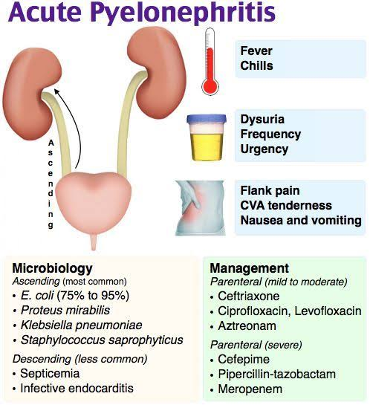

Slide 17
CHRONIC PYELONEPHRITIS
The term chronic pyelonephritis’ means persistent presence of bacteria in the kidney.
Pathogenesis
I. Ascending infection.— In majority of these cases the source of bacteria comes from the bladder by ascending infection. In case of females it often comes from the urethra. If ureterovesical junction is grossly abnormal bacteria in the bladder reach the kidney and true chronic pyelonephritis continues.
II. Haematogenous infection.— When there is no ureterovesical reflux, haematogenous infection causing chronic pyelonephritis is possible. But this usually occurs secondary to some ureteral obstruction e.g. ureteral stone.

Slide 18
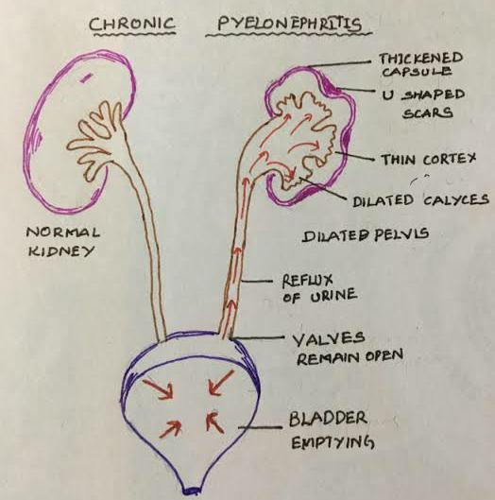

Slide 19
Pathology
MACROSCOPICALLY, the kidney is of normal size or smaller depending on duration of the disease. The capsule becomes pale, yet it cannot be stripped easily. Some areas of the surface of the kidney are pitted and depressed due to scarring.
The cut surface shows fair demarcation between the cortex and the medulla, but the kidney tissue is pale and fibrotic. The pelvic mucosa is also pale and fibrotic.
MICROSCOPICALLY, the kidney parenchyma is diffusely infiltrated with plasma cells and lymphocytes.
The renal tubules are mostly affected and these are atrophic, dilated and cystic. Considerable thickening of the arteries and arterioles is evident and this is the cause of renal hypertension which is seen in half the cases.

Slide 20
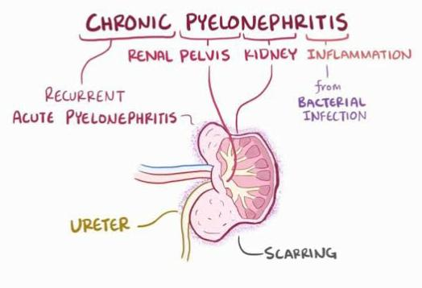

Slide 21
Clinical features
This condition is more common in females (3:1). While majority of the females are below 40 years of age, majority of the males affected are above 40 years of age. SYMPTOMS.— It must be confessed that chronic pyelonephritis may remain asymptomatic until renal insufficiency takes place. (i) Mild discomfort or dull pain over the kidney is complained of in majority of cases. (ii) Vesical irritability in the form of increased frequency, urgency and dysuria may be noticed. (iii) Hypertension is seen in half the cases. (iv) Vague gastro-intestinal complaints are often seen. (v) Constitutional symptoms e.g. lassitude, headache, malaise, nausea and anorexia are seen in 40% of cases. Anaemia is a very common accompaniment of this disease. (vi) Pyrexia is not very important, yet this is seen in about 10 to 20% of cases.

Slide 22
PHYSICAL SIGNS.— 1. Hypertension is discovered in half the cases. 2. Some degree of localised renal tenderness may be elicited
Special Investigations 1. BLOOD EXAMINATION shows slight leucocytosis. Anaemia is present in almost all cases. 2. URINE EXAMINATION shows decreased protein content. Renal function tests should always be performed. 3. X-RAY.— Straight X-ray may show small atrophic kidney. Voiding cystourethrography should be performed. 4. CYSTOSCOPY

Slide 23
Treatment
1. MEDICAL TREATMENT.— Suitable drugs include —
Mandelic acid and its salts are quite effective against coliform organisms and Strept. faecalis.
Ammonium chloride of about 2 g may be given together with the previous drug 6 hourly.
Sulphonamides e.g. urolucosil. septran (sulphonamide mixed with trimethoprim) are quite effective in controlling E.coli infection and some strains of Proteus Furadantin (nitrofurantoin) is a synthetic antibacterial agent which is particularly effective against E.coli.
Co-trimoxazole (Bactrim or Septran) is a combination of trimethoprim and sulphamethoxazole which together block two steps in the bacterial synthesis of folic acid
Nalidixic acid is active against E.coli, Proteus. Klebsiella.
Alkalising agents provide symptomatic relief by raising the pH of urine. Phenazopyridine hcl. is helpful in relieving pain during urinary infection (urinary tract analgesic).

Slide 24
2. SURGICAL TREATMENT
(i) If any obstruction is detected, this should be removed surgically.
(ii) If vesicoureteral reflux has been demonstrated and is considered to be the cause of lingering chronicity, repair of the ureterovesical junction should be considered.
(iii) If one kidney is badly damaged, nephrectomy should be considered.
(iv) When the hypertension has become malignant type and the cause is chronic pyelonephritis, if the other kidney is normal, nephrectomy of the affected kidney is curative
(v) Partial nephrectomy of a badly damaged portion of the kidney may be necessary.
(vi) When this condition affects both the kidneys badly with uncontrolled hypertension, transplantation of kidney or recurrent dialysis should be considered

Slide 25
homoeopathic THERAPEUTICS
Apish Mellifica
Staphysagria
Cantharis
Terebinthina
Sarsaparrilla
Berberis vulgaris
Chimaphila Umbeliata
Eucalyptus globulus

Slide 26
Apish Mellifica
Burning and soreness when urinating.
Suppressed, loaded with casts; frequent and involuntary; stinging pain and strangury; scanty, high colored.
Last drops burn and smart.
Coffee ground sediment.
Cannot urinate without a stool.
Fever.--Afternoon chill, with thirst; worse on motion and heat. External heat, with smothering feeling. Sweat slight, with sleepiness.
Modalities.-
Worse:-heat in any form; touch; pressure; after sleeping; Right side.
Better, in open air, uncovering, and cold bathing.

Slide 27
2.Staphysagria
Nervous affections with marked irritability, diseases of the genito-urinary tract and skin, most frequently give symptoms calling for this drug.
Ineffectual urging to urinate in newly married women.
Sensation as if a drop of urine were rolling continuously along the channel. Burning in urethra during micturition.
Urging and pain after urinating.
Modalities.-
Worse:- anger, indignation, grief, mortification, loss of fluids, onanism, sexual excesses, tobacco.
Better:- warmth, rest at night.

Slide 28
3.Cantharis
Intolerable urging and tenesmus.
Nephritis with bloody urine.
Violent paroxysms of cutting and burning in whole renal region, with painful urging to urinate; bloody urine, by drops.
Intolerable tenesmus; cutting before, during, and after urine.
Urine scalds him, and is passed drop by drop.
Constant desire to urinate.
Membranous scales looking like bran in water.
Pain in loins, with incessant desire to urinate.
Fever.--Cold hands and feet; cold sweat. Soles burn. Chill, as if water were poured over him.
Modalities.--Worse, from touch, or approach, urinating, drinking cold water or coffee.

Slide 29
4.TEREBINTHINA
Inflamed kidneys following any acute disease.
Urine smoky with coffee ground or thick, yellow, slimy, muddy sediment, odor of violets.
Burning pain in region of kidneys. Drawing in right kidney extending to hip.
Burning pain along ureters.
Strangury with bloody urine.
Constant tenesmus.
Fever.--Heat, with violent thirst, dry tongue, profuse cold, clammy sweat.
Modalities
Worse:- cold, night, lying, pressure.
Better:- motion and stooping.

Slide 30
5.Sarsaparilla
Painfully urination, extorts screams, < at the close of urination.
Pain from right kidney downward.
Pus in urine.
Colic and backache at same time.
Urine scanty, slimy, flaky, sandy, bloody.
Urine dribbles while sitting.
Can pass urine only when standing during the day, but at night urine flows freely in bed.

Slide 31
6.BerberiS vulgaris
It causes inflammation of kidneys with hćmaturia.
Sticking pain from kidney, extending along ureter, or to liver, stomach, spleen, arresting breathing.
Urine is thick, turbid, yellow, red, mealy, sandy or slimy sediment.
Pain in thighs and hips on urinating.
Burning, soreness or bubbling in kidney region.
Sensation as if some urine remained after urinating.
Fever.--Cold sensation in various parts, as if spattered with cold water. Warmth in lower part of back, hips, and thighs.
Modalities.--Worse, motion, standing.

Slide 32
7.Chimaphila umbellata
Urine turbid, scanty, offensive, containing ropy or bloody mucus, and depositing a copious sediment.
Burning and scalding during micturition, and straining afterwards. Must strain before flow comes.
Fluttering in region of kidney.
Acute inflammation of urinary tract.
Clots of blood pass with urine.
Urging to urinate.
Unable to urinate without standing with feet wide apart and body inclined forward.

Slide 33
8.Eucalyptus globulus
Acute nephritis complicating influenza.
Hæmaturia.
Suppurative inflammation of kidneys.
Urine contains pus and is deficient in urea.
Fevers of a relapsing character.
Urine has the odour of violets.

Slide 34
References
A CONCISE TEXTBOOK OF SURGERY BY SOMEN DAS; 10TH EDITION .
BAILEY AND LOVE’S SHORT PRACTICE OF SURGERY EDITED BY R.C.G. RUSSELL, NORMAN S. WILLIAMS AND CHRISTOPHER J.K. BULSTRODE; 23RD EDITION.
SELECT YOUR REMEDY BY RAI BAHADUR BISHAMBAR DAS; 25TH REVISED EDITION.
POCKET MANUAL OF HOMOEOPATHIC MATERIA MEDICA AND REPORTORY BY DR. WILLIAM BOERICKE.
MATERIA MEDICA OF HOMOEOPATHIC MEDICINES BY DR. S.R. PHATAK; 2ND REVISED AND ENLARGED EDITION.

Slide 35
Thank you

