Slide 1
THALASSEMIA
&
HOMOEOPATHY

Slide 2
DEFINITION: Thalassemia is blood disorder passed down through families (inherited) in which the body makes an abnormal form or inadequate amount of haemoglobin.
CAUSE: Haemoglobin made of 2 proteins:
alpha globin & beta globin
Thalassemia occurs when there is a defect in a gene that helps control production of one of these proteins.
TYPES:
Alpha thalassemia occurs when a gene or genes related to the alpha globin protein are missing or changed (muted). Most common in people of Southeast Asia, Middle East, China, African descent.
Beta thalassemia occurs when similar gene defects affect production of the beta globin protein. Most common in Mediterranean origin.

Slide 3
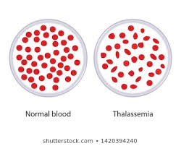
Alpha & Beta Thalassemia include the following 2 forms:
-Thalassemia Minor
-Thalassemia Major
Thalassemia Major occurs when inherit the gene defect from both parents.
Thalassemia Minor occurs when receive the faulty gene from only one parent.
NORMAL
THALASSEMIA

Slide 4
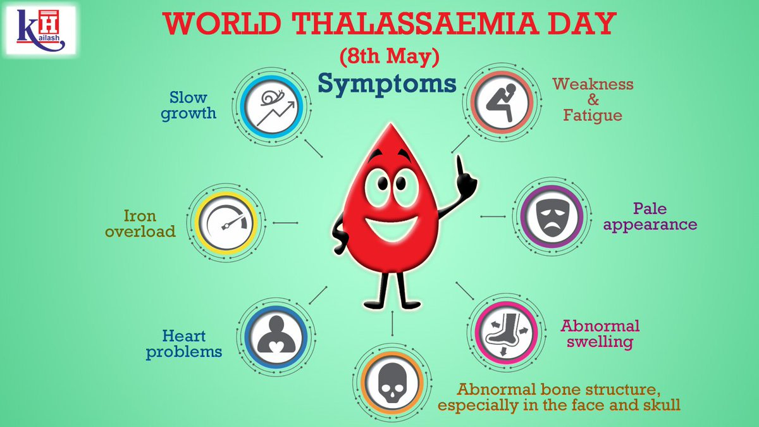
SIGNS & SYMPTOMS:
- paleness
- tiredness, low energy, muscle weakness
- lightheadedness or shortness of breath
- lack of appetite
- dark urine
- jaundice
- in children slow growth and delayed puberty
- bone deformities of face
- abdominal swelling
- wide or brittle bones
- enlarged spleen
- heart problems

Slide 5
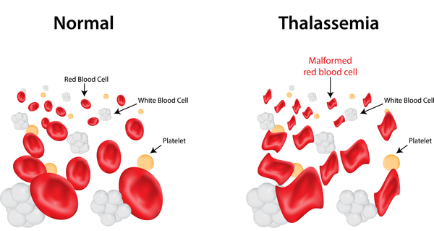
INVESTIGATIONS:
- CBC
- Blood smear (peripheral smear & manual differential
* RBC: Microcytic, hypochromic, anisocytosis, poikilocytosis, nucleated, uneven Hb distribution ( producing “target cells” that look like a bull’s eye under the microscope)
- Iron studies
- Hemoglobinopathy evaluation ( Hb electrophoresis)
- DNA analysis
- Genetic testing of amniotic fluid
TREATMENT:
- Genetic counselling
- Blood transfusion
- Folic acid supplementation
- Chelation therapy
- Hematopoetic stem cell transplantation (bone marrow transplant)

Slide 6
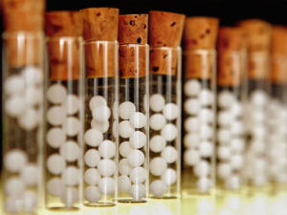
HOMOEOPATHIC APPROACH:
ANTIPYRINUM :
- red blood cells are different cells.
ARSENIC ALBUM:
- abnormally large red cells.
- anaemia on account of degenerative changes in the blood.
BUTYRICUM ACIDUM:
- cure cell anaemia-thalassemia.
CALCAREA ARS:
- use for increase hemoglobin and red blood cells.
FERRUM MET:
- for thalassemia major, hereditary or genetically transmitted abnormalities with familial or
racial incidence-mostly found in children. Worse in winter.

Slide 7
LACHESIS:
- after transfusion of blood it wil stop its further decomposition.
- the interval between blood transfusion is increased and progress of
disease is retarded.
NATRIUM CACODYL:
- increases the no. of red cells almost to double.
PHOSPHORUS:
- stops further disorganization of blood.
- skin is very pale & jaundice may be present.
PICRIC ACID:
- progressive abnormality of red cells which become larger than normal
resulting in pernicious anemia.

Slide 8
PLUMBUM MET:
- rapid reduction in no. of red blood cells causing great paleness of skin.
- cramps in calves.
- twitching of muscles.
THIOSINAMINUM:
- cures wasting of spinal marrow - tabes dorsalis.
THYROIDINUM:
- used in anemia, emaciation, muscular weakness & some thyroid troubles.

